Slide 1

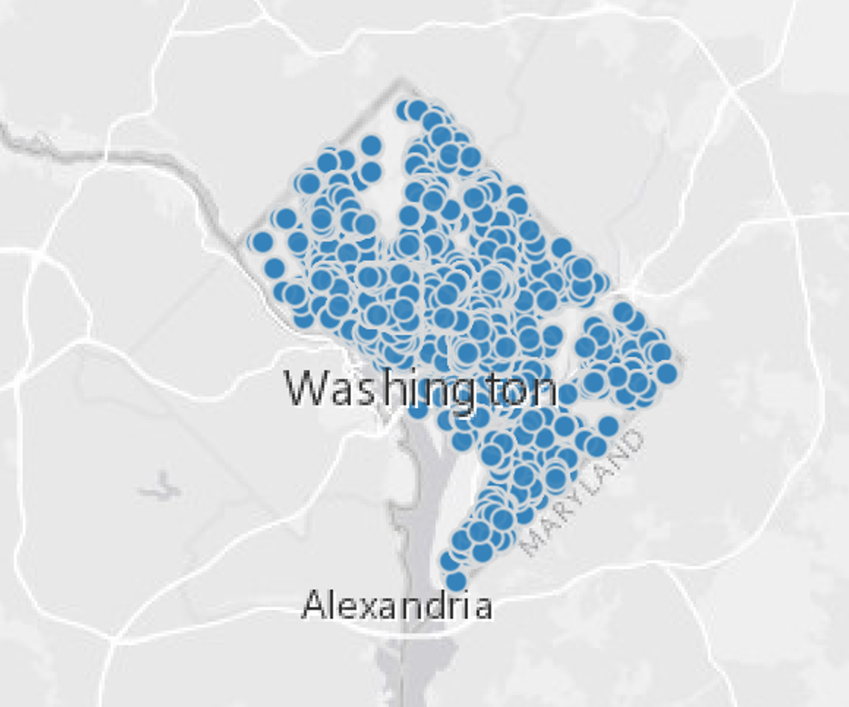
Development of Building Specific Metamodels using Washington, DC Benchmarking Data to Infer Interval Data
Nicholas Long
CVEN5830 – Grid Connected Systems
April 28, 2020

Slide 2
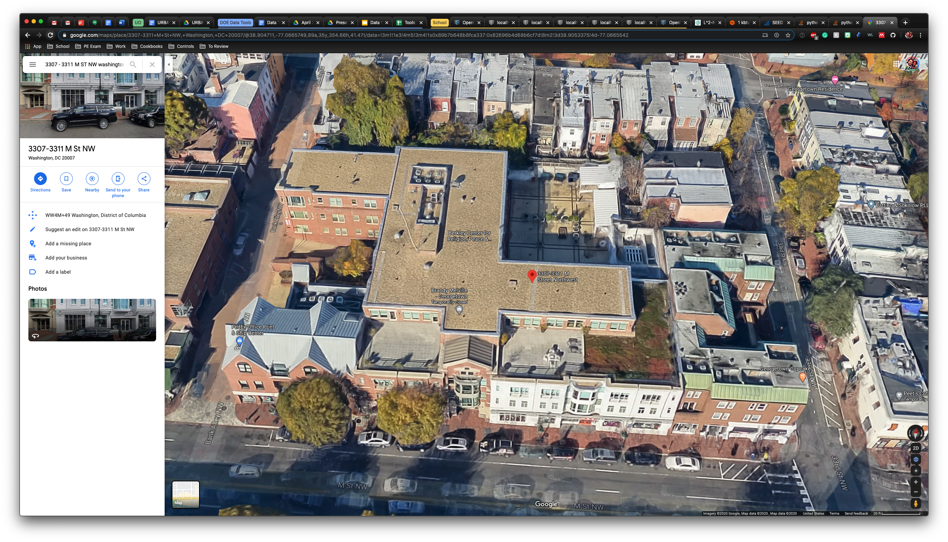
Research Question
How can high-level building benchmarking data be used to generate realistic annual load profiles of buildings using metamodels?
Can metamodels be used to approximate building loads?
Outline
Disclosure Data Analysis
Building Energy Modeling Results
Metamodeling
Calibration and load aggregation

Slide 3




Analysis Workflow
Inspect Disclosure Data
Parametric Analysis of BEM
Create Metamodels
Extract n Candidates
Post Process BEM
Cross-validate Metamodels
Covariate ranges
BEM Results
Building Parameters
Calibrate Model
Model Definition
Aggregate Loads
Model Definition
Model Definition

Slide 4
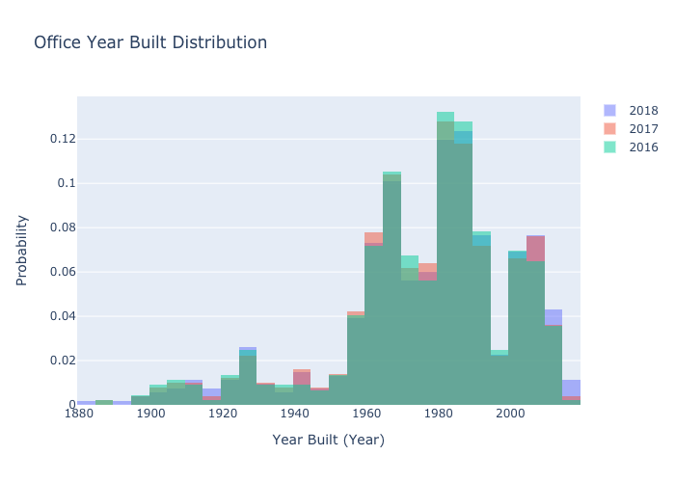
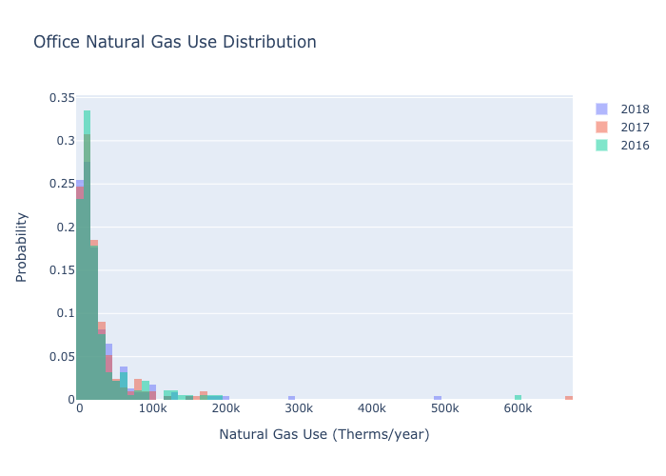
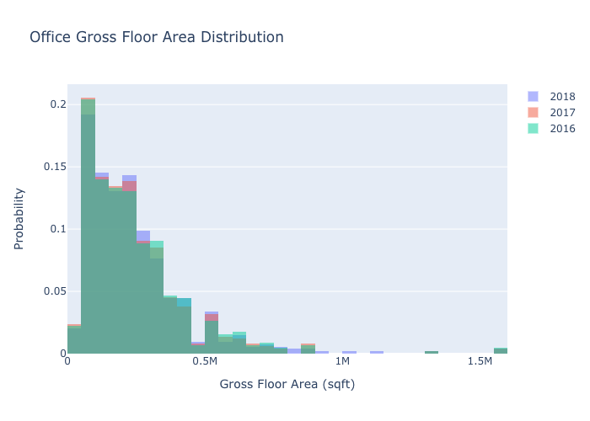
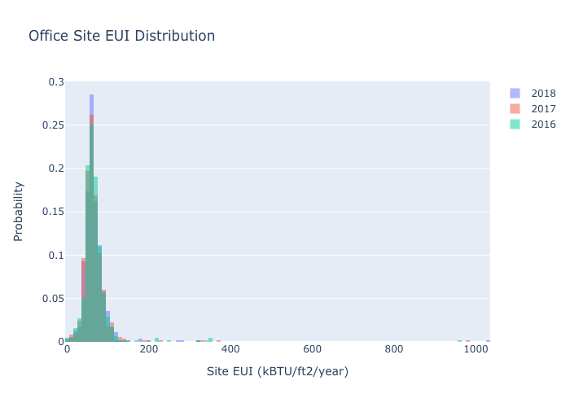
Disclosure Data Analysis
2018 had 1,798 disclose properties
54 Building types
Input | B0 | B1 | B2
Address | 1146 19th Street | 3307 - 3311 M ST NW | 1235 W Street NE
Floor Area (ft²) | 47083 | 54560 | 38964
Year Built | 1986 | 1991 | 1993
Site EUI (kBtu/ft²/year) | 59 | 84.1 | 43.9
Electricity Use (kWh) | 814,091 | 1,344,206 | 323,703
Natural Gas Use (Therms) | 0 | 0 | 6042.4

Slide 5
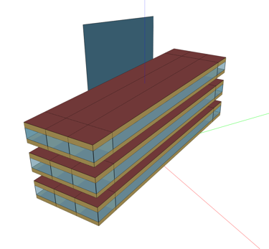
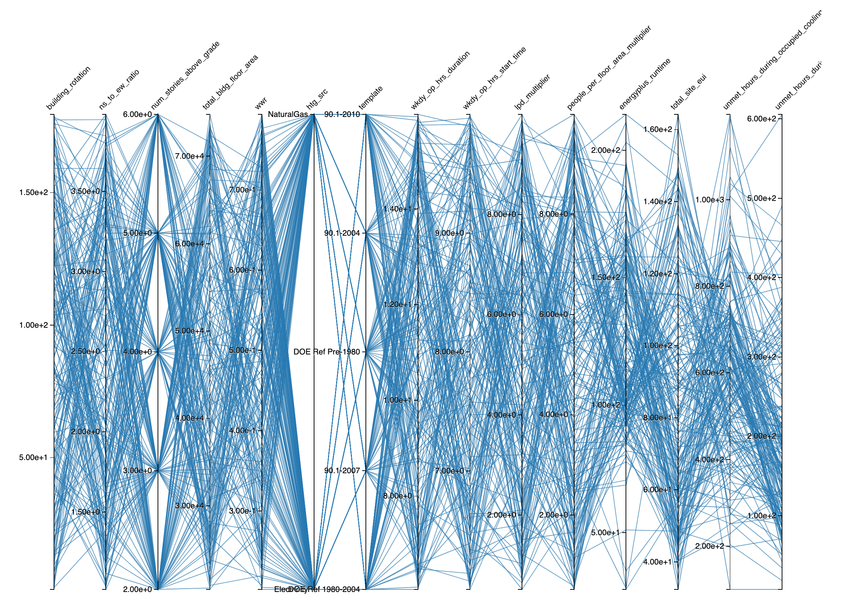
BEM Parametric Analysis
Measure Name | Variable Name | Type | Value
Building from Building Type Ratios | Primary Building Type | Static | MediumOffice
 | Floor Area | Continuous (Uniform) | [20,000, 75,000]ft²
 | Number of Stories | Discrete (Uniform) | [2, 3, 4, 5, 6]
 | Building Rotation | Continuous (Uniform) | [0, 180]°
 | Aspect Ratio | Continuous (Uniform) | [1, 4]
 | Window to Wall Ratio | Continuous (Uniform) | [0.2, 0.8]
Change Building Location | Weather File Name | Static | USA_VA_Arlington-Ronald.Reagan.Washington.Natl.AP.724050_TMY3.epw
Typical DOE Building | Target Standard | Discrete (Uniform) | [Pre-1980, 1980-2004, 90.1-2004, 90.1-2008, 90.1-2010]
 | Heating Source | Discrete (Uniform) | [Electricity, NaturalGas]
 | Hours of Operation Start Time | Continuous (Uniform) | [6,10]
 | Hours of Operation Duration | Continuous (Uniform) | [6,16]
Internal Loads | LPD Multiplier | Continuous (Uniform) | [0.5, 10]
 | People Multiplier | Continuous (Uniform) | [0.5, 10]
300 Samples
3-4 minutes per simulation

Slide 6
Metamodels
Source: https://xkcd.com/2048/

Slide 7
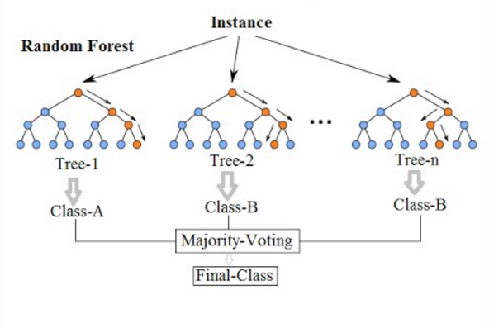
Random Forest
Ensemble method using multiple decision trees
Parameters (of interest) include:
Max depth, max features, min samples/leaf, min samples/split, and number of estimators
If classification then majority voting. If regression then average of all trees
Source: https://cdn-images-1.medium.com/max/1600/1*i0o8mjFfCn-uD79-F1Cqkw.png

Slide 8
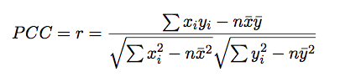
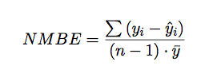
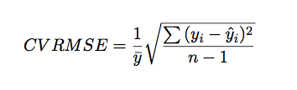
Training Methodology
All Samples
A downsampling variable was used to prevent overfitting of the data. Value was set to 5%
Training Dataset
Test Dataset
Withheld 8760-Contiguous Validation Dataset
Model performance used PCC on test dataset
Validation dataset evaluated using NMBE and CVRMSE

Slide 9
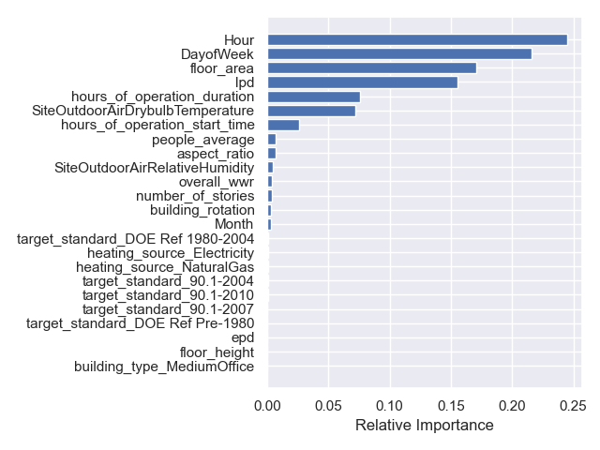
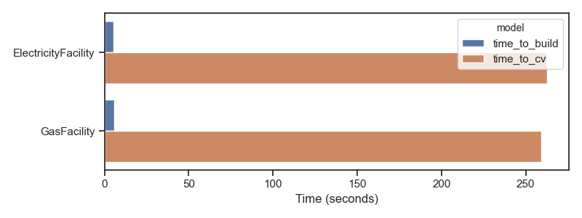
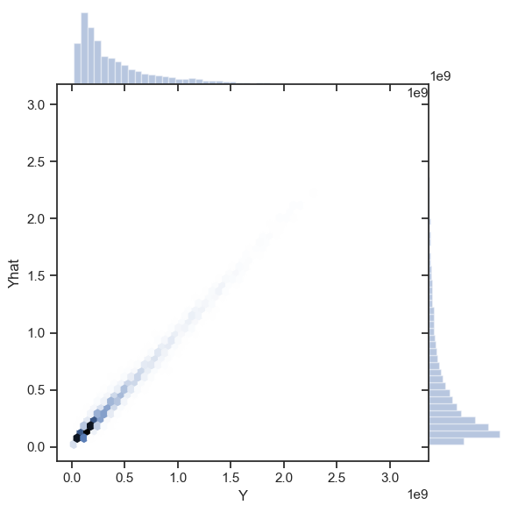
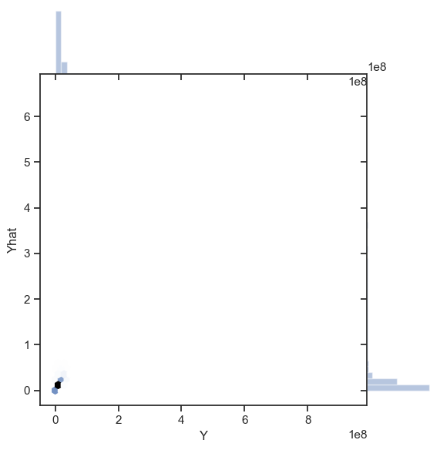
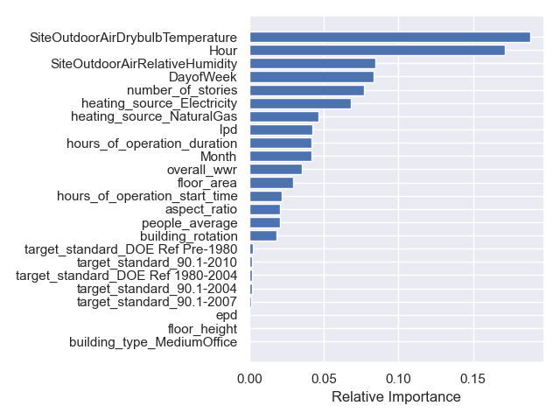
Random Forest Fitting with Cross Validation
Electricity Consumption
Gas Consumption
Electricity consumption
Gas consumption

Slide 10
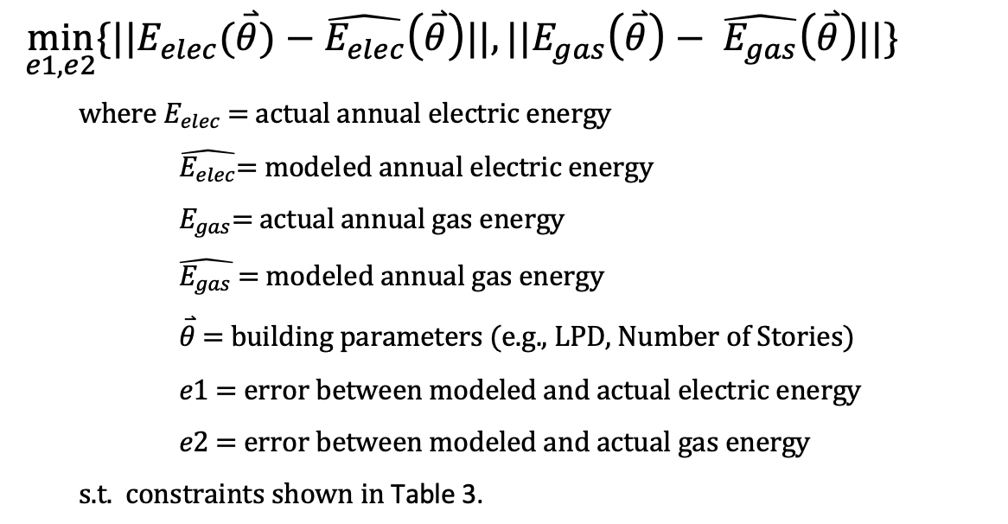
Calibration Formulation

Slide 11
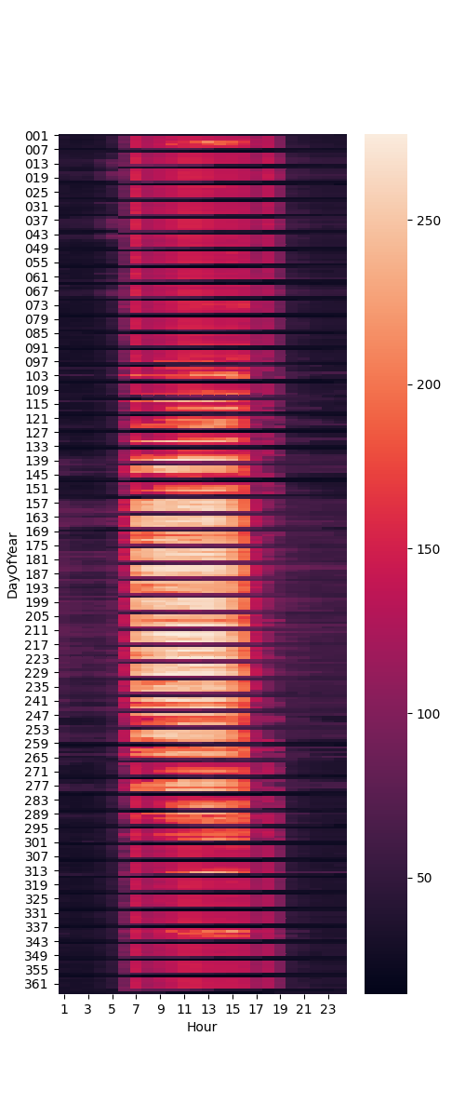
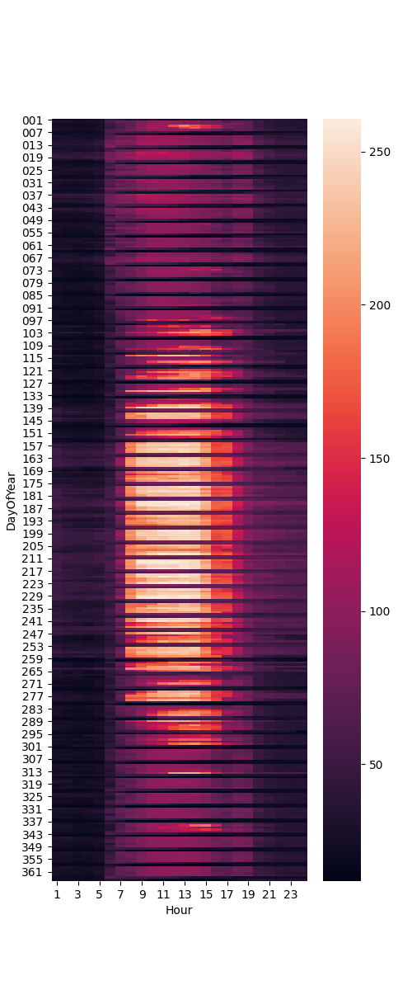
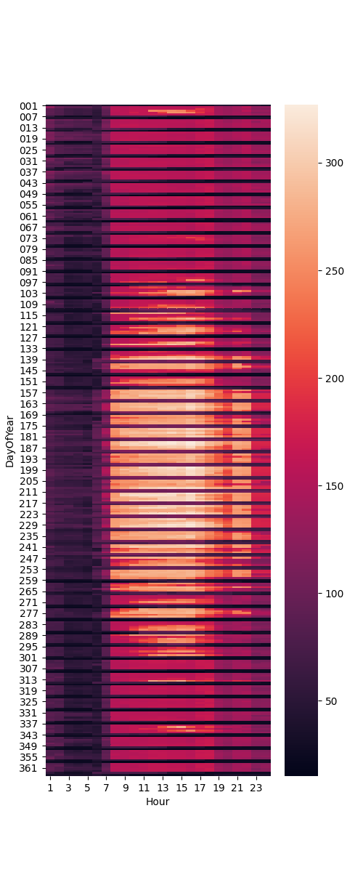
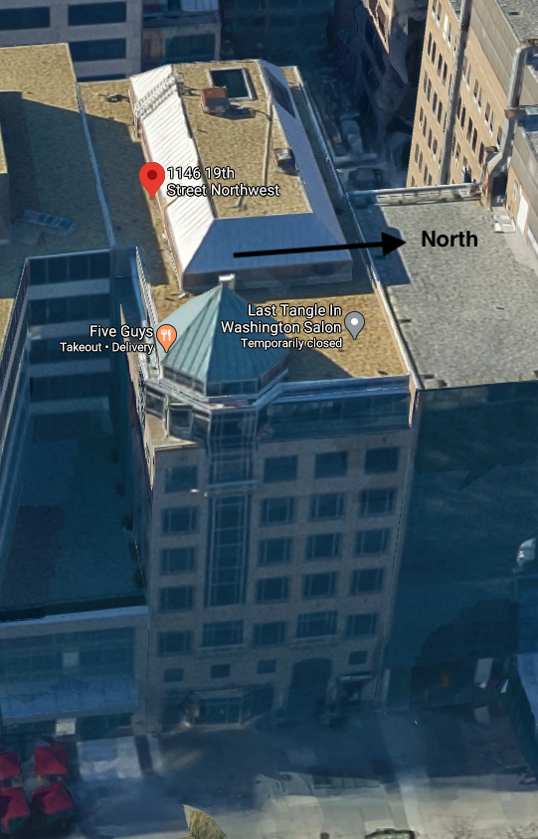
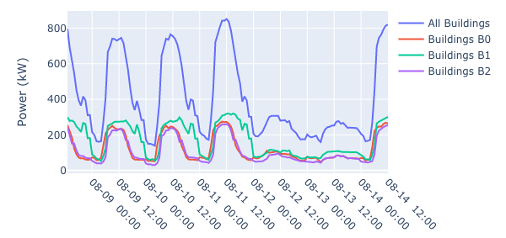
Calibration Results and Load Aggregation
Input | B0 | B1 | B2
Floor Area (ft²) | 47083 | 54560 | 38964
Number of Stories | 4 | 6 | 11
Aspect Ratio | 1.4 | 4.9 | 3.5
Hours Start | 6 | 9:45 | 9:30
Hours Duration | 9 | 14 | 8:45
Lighting Power Density (W/ft²) | 16 | 19 | 1.4
Heating Source | Electricity | Electricity | NaturalGas
Peak Weak
Building 0
Building 1

Slide 12
Thank you!
Nicholas.L.Long@Colorado.edu

